Slide 1
British Airways
Predicting customer buying behavior for British Airways

Slide 2
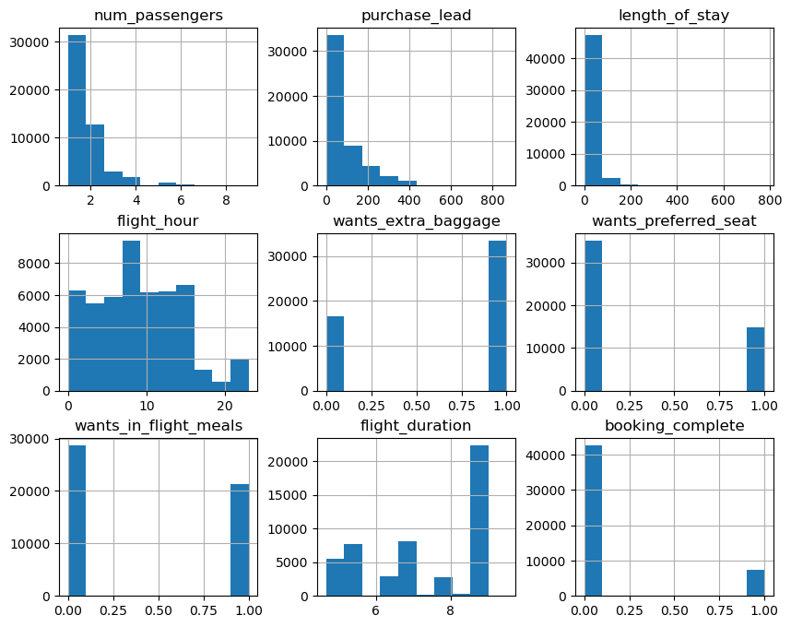
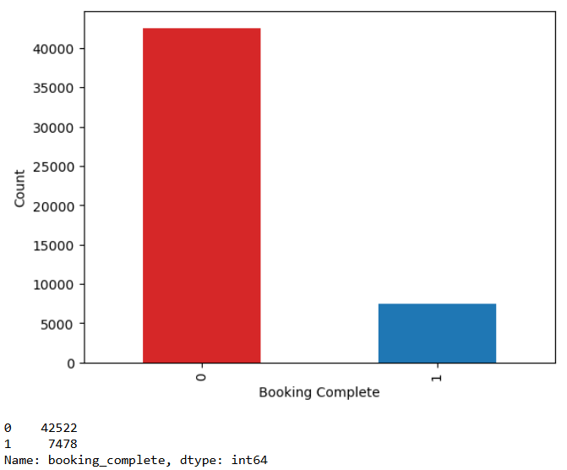
Insights of the Dataset
There are 50000 rows with 14 columns.
There are 5 categorical variables : sales_channel, trip_type, flight_day, route, booking_origin
There are 9 numerical variables : num_passengers, purchase_lead, length_of_stay, flight_hour, wants_extra_baggage,wants_preferred_seat, wants_in_flight_meals, flight_duration, booking_complete
Dataset is highly Imbalanced

Slide 3
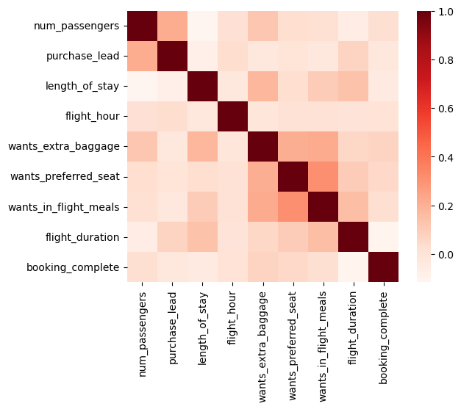
Bivariate Analysis
Insights from Correlation Heatmap:
Low Target Correlations:
The target variable, booking_complete, shows weak correlations with most features.
The strongest positive correlation is with purchase_lead, though still weak.
Feature Interdependencies:
Moderate positive correlation between length_of_stay and flight_hour, suggesting a possible connection between longer stays and specific flight timings.
Correlations between wants_preferred_seat, wants_in_flight_meals, and wants_extra_baggage indicate that passengers seeking one additional service are likely to seek others.
Minimal Multicollinearity:
Most features have low inter-correlation, which could prevent multicollinearity issues, benefiting model performance.
Next Steps:
Feature Importance: Techniques like Random Forest or Gradient Boosting Trees could reveal feature importance.
Feature Engineering: Consider combining correlated features (e.g., extra services) or adding new features to capture hidden patterns.

Slide 4
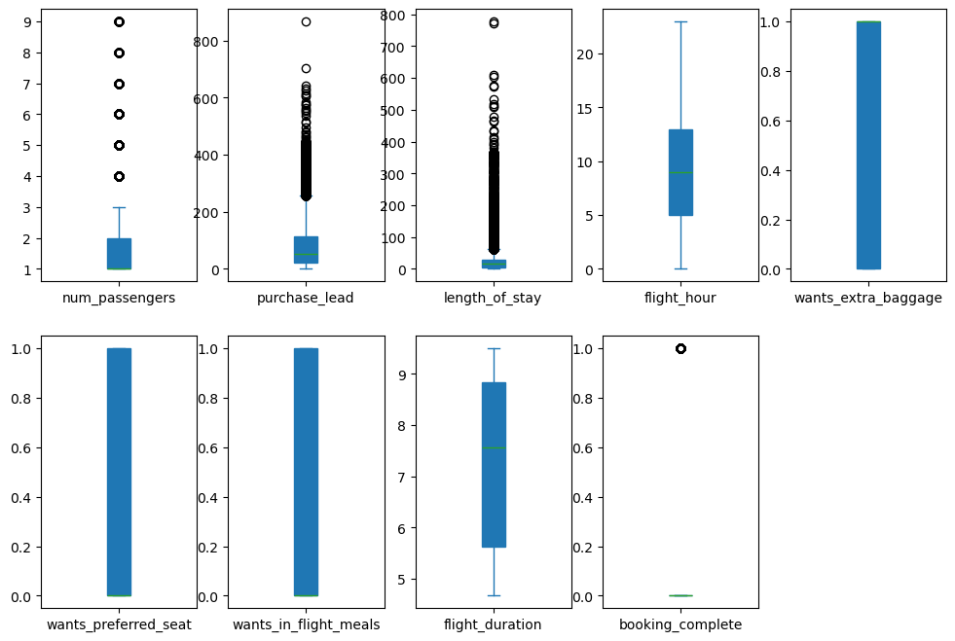
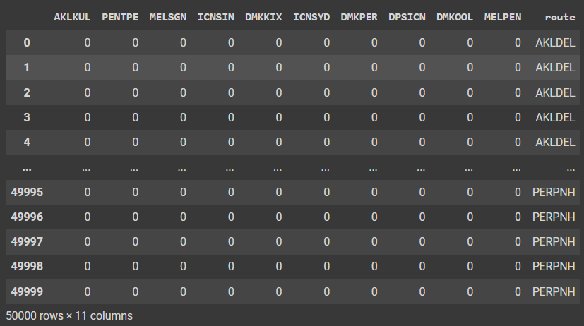
Data preprocessing & feature engineering
There is no null values
Detect outliers and apply median imputation
Combined correlated features to create new feature named total_service_requested.
Apply one hot encoding to handle categorical features
Also applied a technique called one-hot encoding for top categories or targeted one-hot encoding.
Applied SMOTE to balance the training data
targeted one-hot encoding for route

Slide 5
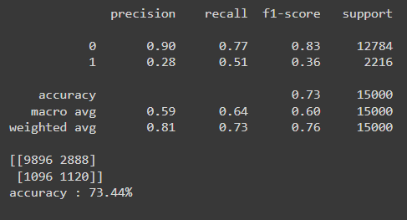
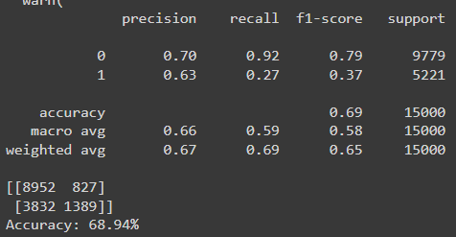
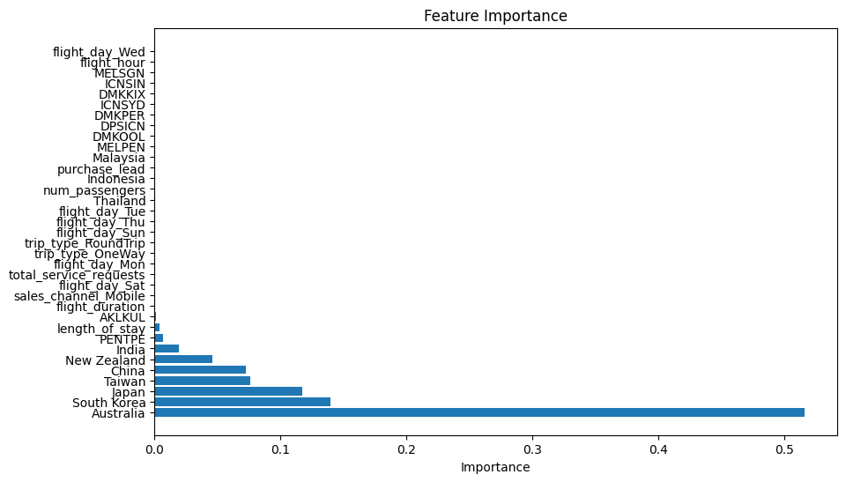
Model Selection and Evaluation
3 different models were tested and fine tunned
RandomForest , BalancedRandomForest, GradientBoosting
Classifier was : RandomForestClassifier
Accuracy of model : 73.44%
Classifier was : BalancedRandomForestClassifier
Accuracy of model : 73.44%

Slide 6
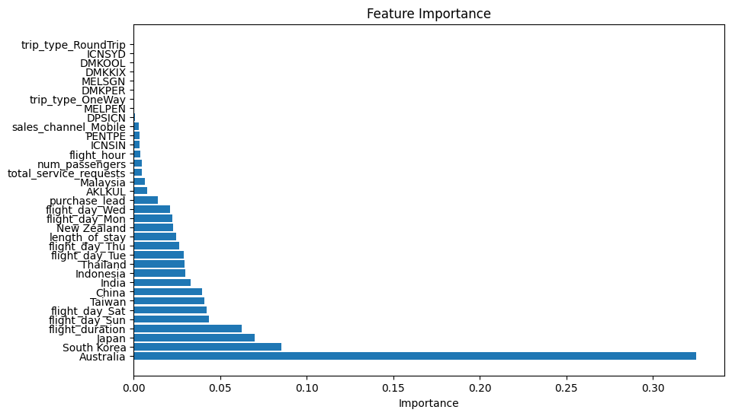
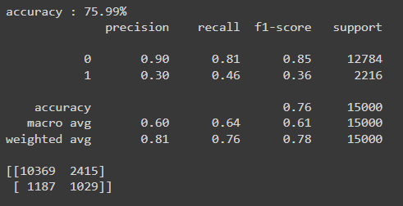
Classifier was : GradientBoostingClassifier
Accuracy of model : 75.99%
Model Interpretation:
Class Imbalance :
The model performs well on the majority class (0) but struggles with the minority class (1)
Low Recall for Class 1:
The model has difficulty identifying positive cases (class 1
High Precision for Class 0:
The model is highly precise in predicting class 0, meaning it effectively avoids false positives for the negative class.

